Slide 1
FOOD SAFETY

Slide 2
Considerations on Food Safety
For the professional…….
….and the amateur

Slide 3
In a Nutshell:
Wash your hands
Keep your workplace clean
Keep hot food consistently hot
Keep cold foods consistently cold

Slide 4
Wash your hands
Before handling or preparing food
Use warm water and soap
“Twinkle, Twinkle Little Star” – wash for at least 30 seconds
Dry your hands with a clean towel

Slide 5
Keep your workspace clean
Use separate cutting boards for produce and raw meat and poultry
Otherwise disinfect thoroughly between food items
Wash produce before handling

Slide 6
Medics and Safety Officers
May want to invest in a pocket food service thermometer
Less than $10.00
Available in any restaurant supply company
Aid in determining food safety
Cold food <40 F
Hot food >140 F
Accept but discard donated food during missions, unless packaged in unopened commercial packaging.

Slide 7
Keep hot food consistently hot
Use a warmer or serve immediately
>140 F
Don’t let food sit out over 2 hours at room temperature
Only 1 hour over 90 F

Slide 8
Keep cold food consistently cold
Keep in refrigerator
Store on ice
Don’t let food sit out over 2 hours at room temperature
Only 1 hour over 90 F
Be very careful with mayonnaise

Slide 9
Keep Drinks in One Cooler

Slide 10
Use a separate cooler for food
Keep lid closed as much as possible
Securely wrap meat and poultry to avoid contaminating produce and fruits

Slide 11
Grilling
Ensure that meat is thoroughly cooked
Poultry >165 F
Ground beef >160 F
Pork >145 F

Slide 12
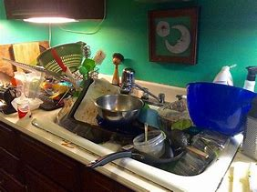
Clean up after yourself

Slide 13
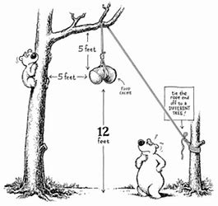
In the field don’t invite critters to supper

Slide 14
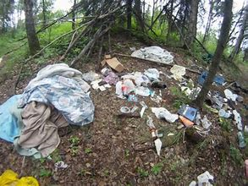
Leave no trace…………………….. ………………Pack out your trash

