Slide 1
Poison Ivy, Oak and Sumac
How to recognize and deal with poison Ivy, Oak and Sumac

Slide 2
Overview
The Bottom Line: many people are quite allergic to the oil in these plants, which can cause a rash.
Poison Ivy and its cousins grow in almost all parts of the USA, and in many other countries.
Poison Sumac grows primarily in wet areas in the eastern half of the country.
Poison Oak looks quite similar to Poison Ivy and tends to grow in dry, sandy areas in the Southeast.
Poison Ivy has two forms: Eastern and Western.
Western Poison Ivy is a ground vine only
Eastern Poison Ivy can grow on the ground, climb trees and walls, and even appear to be a shrub.

Slide 3
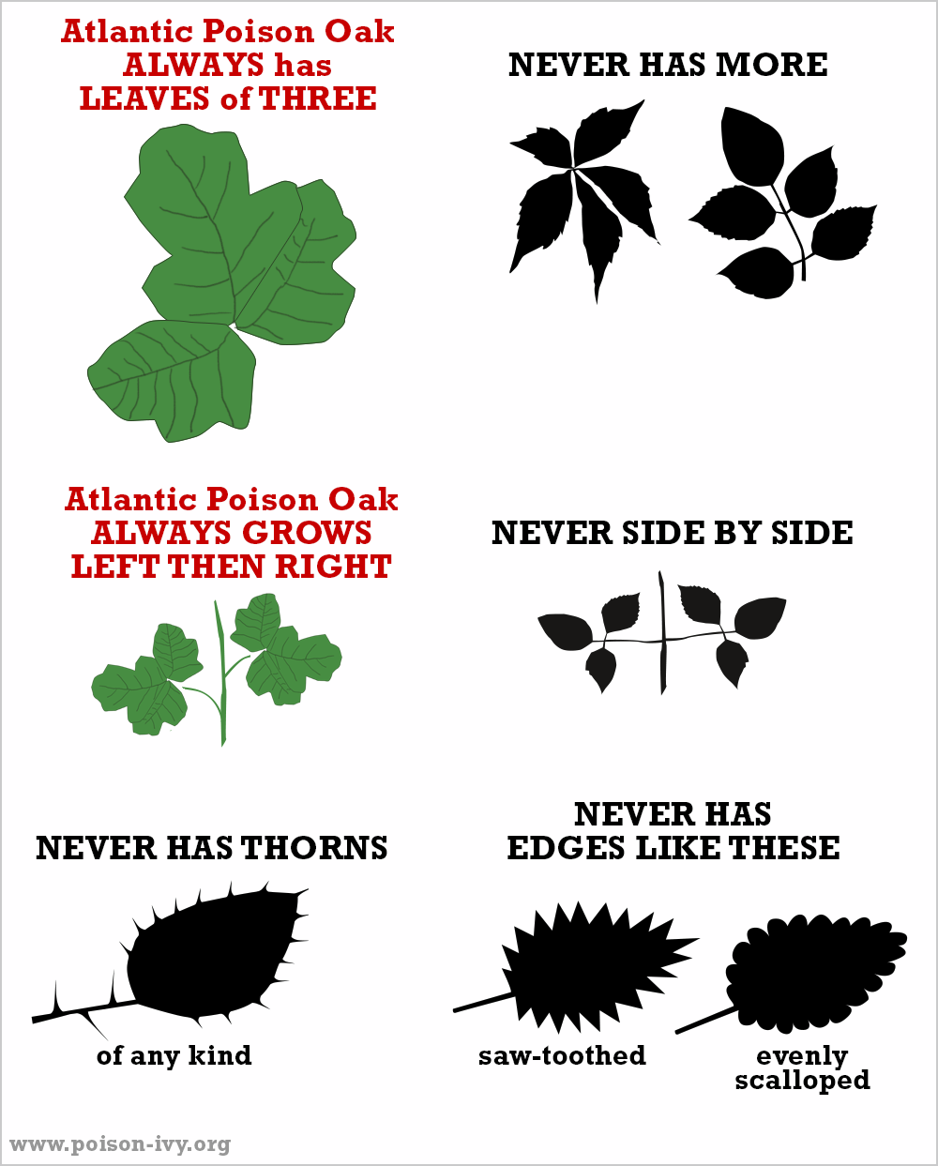
Examples of Poison Ivy and Poison Oak

Slide 4
A Picture of Poison Sumac
Poison Sumac

Slide 5
A Picture of Poison Oak
Poison Oak

Slide 6
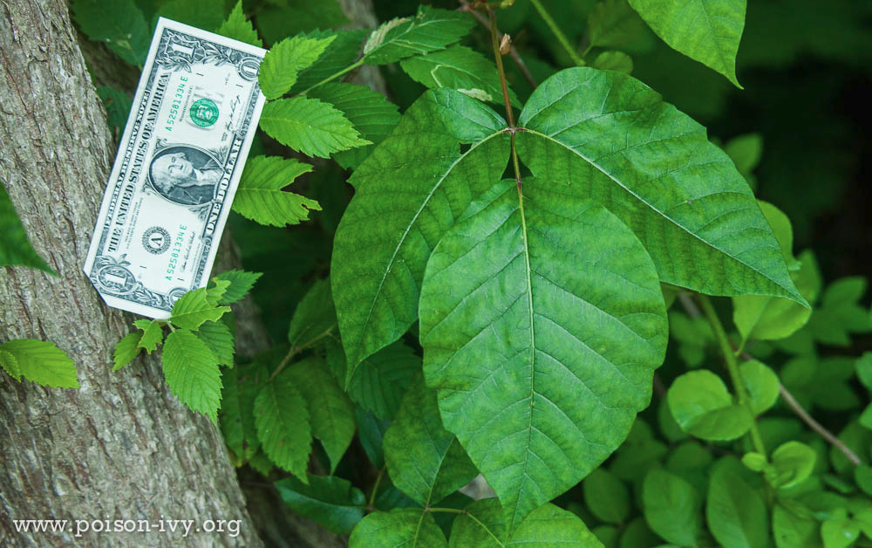
Two Pictures of Poison Ivy
Poison Ivy

Slide 7
Preventing the rash
FIRST: avoid contact if at all possible.
If you suspect that you have been in contact with poison ivy, immediately wash the exposed skin with soap and warm water, or TECNU if it is available. This must be done within 2 hours to be effective.
Make sure to wash clothing (standard laundry soap will disperse the oil) AND your tools. The oil can remain on clothing and tools for months.
The rash is NOT CONTAGIOUS . . . You can’t get it from someone who has a poison ivy rash.
AVOID burning poison ivy, the smoke can carry the oil.

Slide 8
Treating the Poison Ivy rash
You can manage mild to moderate poison ivy at home.
Cool compresses can be soothing
Heat (hot shower or hair dryer) will cause the rash to itch intensely for a short time, but may eliminate the itch for up to 8 hours
Calamine lotion helps with oozing areas
The rash usually lasts 7 – 14 days.

Slide 9
Treating severe Poison Ivy
If you develop a severe rash, consider seeking medical assistance. A course of an oral steroid (like prednisone or decadron) can allow the rash to resolve much more quickly. However, don’t discontinue the steroid too early (at least 7 days) or the rash could recur.
Topical steroid creams can also be helpful and some of these are over the counter.

