Slide 1
SNAKEBITE

Slide 2
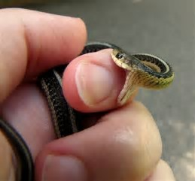
2 Categories of Snakes in the USA (For our purposes)
Non-venomous Snakes
Venomous Snakes
Pit Vipers
Rattlesnakes
Copperheads
Water Moccasins
Coral Snakes

Slide 3
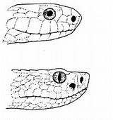
How to Tell the Difference
NON Venomous Snake
Rounded Head
Round Pupil
Pit Viper (Venomous)
Triangular Head
Elliptical Pupil
Pit between eye and nostril

Slide 4
How to Tell the Difference #2
NON Venomous
Rounded Head
Venomous
Triangular or Arrowhead Head

Slide 5
How to Tell the Difference #3 For the Foolhardy
NON Venomous
Split Tail Plates
Venomous
Single Tail Plates

Slide 6
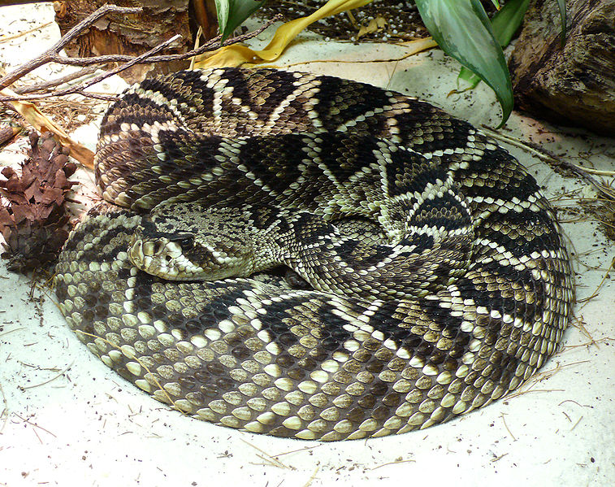
Eastern Diamondback Rattlesnake

Slide 7
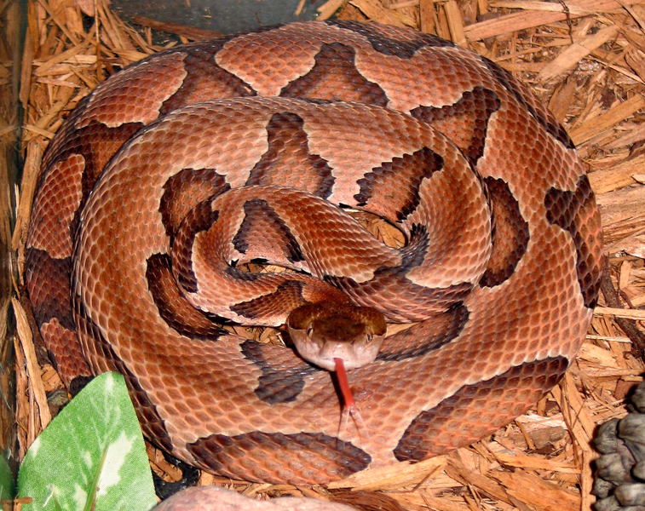
Copperhead

Slide 8
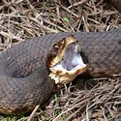
Water Moccasin

Slide 9
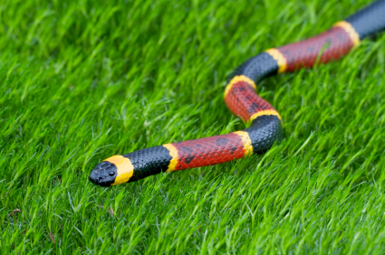
Coral Snake “Red next to yellow, You’re a dead fellow”

Slide 10
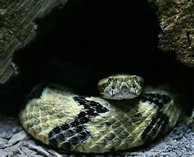
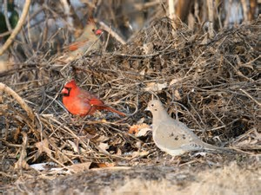
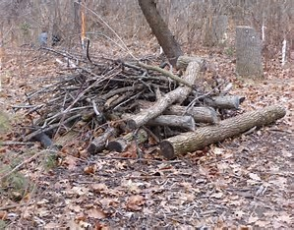
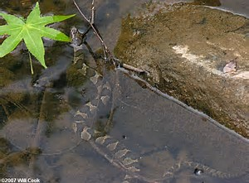
Where Do We Find Snakes?

Slide 11
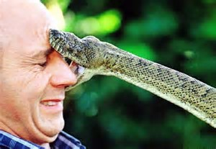
So, You Are Bitten By a Snake

Slide 12
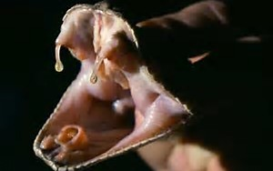
Pit Viper

Slide 13
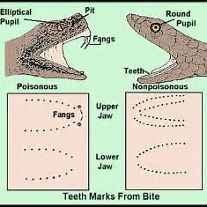
It Will Leave a Mark!

Slide 14
So, What is the Risk?
8,000 venomous snakebites per year in US
8 deaths
Almost ALL people live DESPITE what is done to them

Slide 15
Who is Bitten? Hey ya’ll watch this!
Majority of snakebites occur during intentional interaction with snake
White males 25-34 years old
Alcohol and/or drugs impairment are common
Frequently occur while trying to catch or kill a wild snake
Where is the bite?
Intentional Interaction
Upper extremities
Accidental contact with snake
Lower extremities (foot and ankle)

Slide 16
What Affects Severity of Bite
Don’t despair, all is not lost
Dry bite
No venom is injected
You are injected with venom – what affects the outcome
Size and age of snake (young snakes can be worse than older snakes)
When was snake’s last meal
Threat perceived by the snake
Emotional state of snake
Size and age of the victim

Slide 17
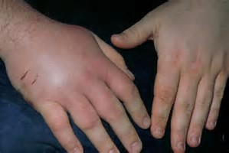
Signs and Symptoms of Snakebite
Severe pain at bite site
Redness and swelling
Puncture wound
Numbness and tingling
Nausea or vomiting
Breathing difficulty
Vision disturbance

Slide 18
Treatment of Snakebite
Don’t get anyone else bitten!!
Lay the person down
Bite at level of heart
Keep calm and at rest
Treat the wound with usual first aid measures
Apply a splint
Remove tight clothing, shoes or jewelry
Evacuate on a Stretcher!
Call 911

Slide 19
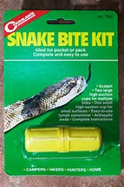
No, No, No……NEVER!

Slide 20
Do Not:
Molest the snake
Delay medical attention
Apply a tourniquet or constricting band
Perform kitchen-table surgery (No “X” over the bite)
Suck out the venom
Apply ice
Give alcohol as painkiller (It really isn’t snake bite medicine)

