Slide 1
FIELD SANITATION

Slide 2
What we are talking about today
Water purification in the field
Safe food storage
Waste management
“Biological” waste
Trash and garbage

Slide 3
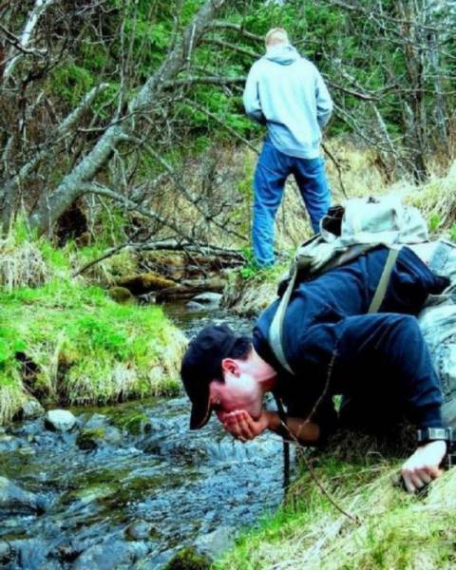
Don’t drink unpurified water!

Slide 4
Water Purification Methods
Chemical purification
Chlorine based
Iodine Based
Electrolytic based
Filtration
Boiling

Slide 5
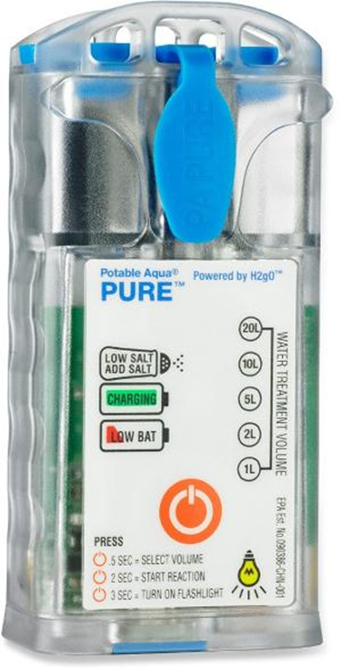
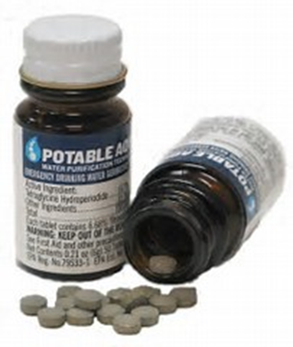
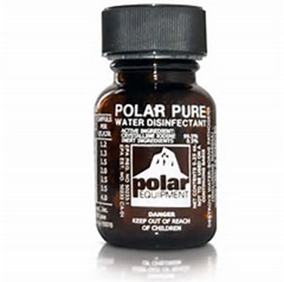
Chemical Purification
Rely on iodine or chlorine to kill bacteria and viruses
Use tablets containing chlorine or iodine
Electrical generation of chlorine from salt
This method is expensive to purchase
Subject to breakage in field environment
Be wary of military surplus iodine tablets as they may be expired!

Slide 6
Chemical Purification
Fill canteen with water
Add water purification tablets
Replace the cap on the canteen
After five minutes, loosen cap
Shake canteen to spill a small amount of the chlorinated water out of the canteen onto the threads of the top
Tightly apply cap
Wait 30 minutes
ALWAYS READ LABEL INSTRUCTIONS FOR YOUR PRODUCT!!!

Slide 7
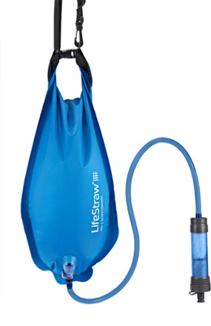
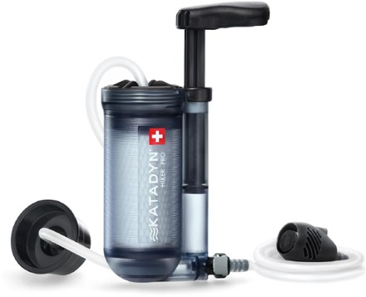
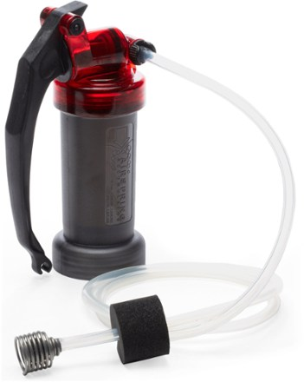
Filtration Methods
Life straw filter suitable for an individual
Remove particulates in water
No chemical taste as with iodine and chlorine methods
No product endorsement intended!

Slide 8
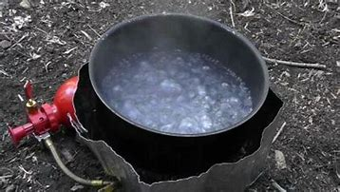
Boiling
Time consuming
Must build a fire
Time to boil water
Takes a long time to cool the water
Water can taste flat

Slide 9
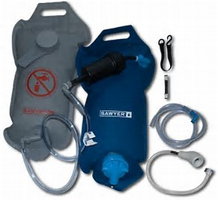
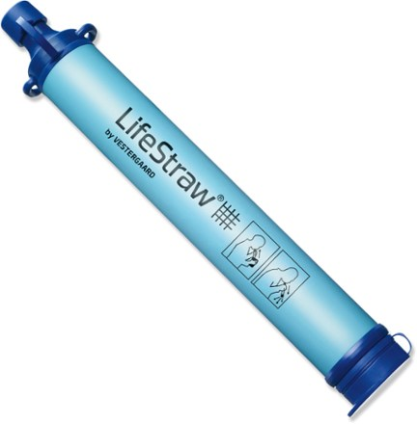
Remember to Purify Water Properly

Slide 10
Safe Food Storage
Keep food covered to prevent insect contact
Eat prepared food promptly to avoid spoilage
Hot food needs to be kept hot
Cold food needs to be kept cold
NO FOOD IN YOUR SLEEPING AREA
Food must be hung at night where bears are a problem

Slide 11
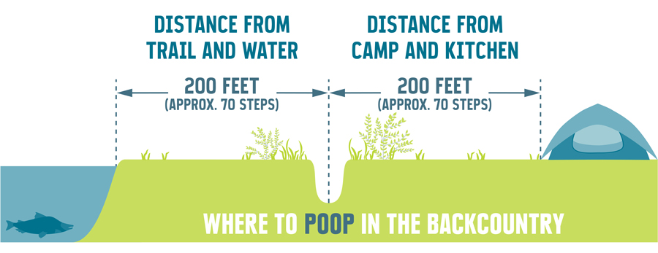
Sanitary Part of Field Sanitation

Slide 12
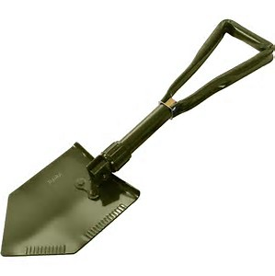
Army Issue Mk 1, Mod 5, Toilet, Portable, Field*
* 1 per team

Slide 13
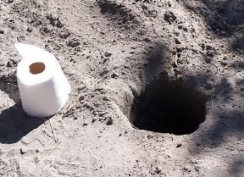
“Cat Hole Latrine”

Slide 14
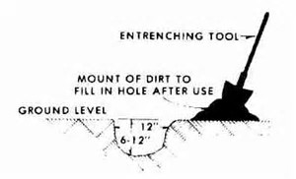

Slide 15
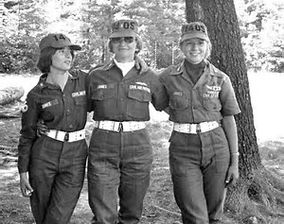
Consider the Needs of Your Teammates
PA Wing Rangers from the 70’s

Slide 16
Everyone Needs Their Privacy

Slide 18
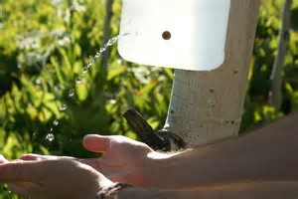
Field Improvisation

Slide 19
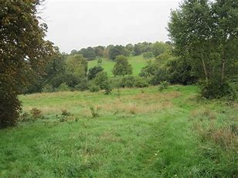
Leave No Trace Behind
What to do with trash
Burn It
Time consuming
Some risk with open fire
Bury it
Risk of animals digging it up
You brought it, You take it with you
This is the BEST choice

